Slide 1

Introduction to Customizations
DYNAMICS 365

Slide 2

Mitch Milam
Dynamics CRM Architect
mitch@xrmcoaches.com
@mitchmilam
http://tinyurl.com/MitchMilamLinkedIn

Slide 3
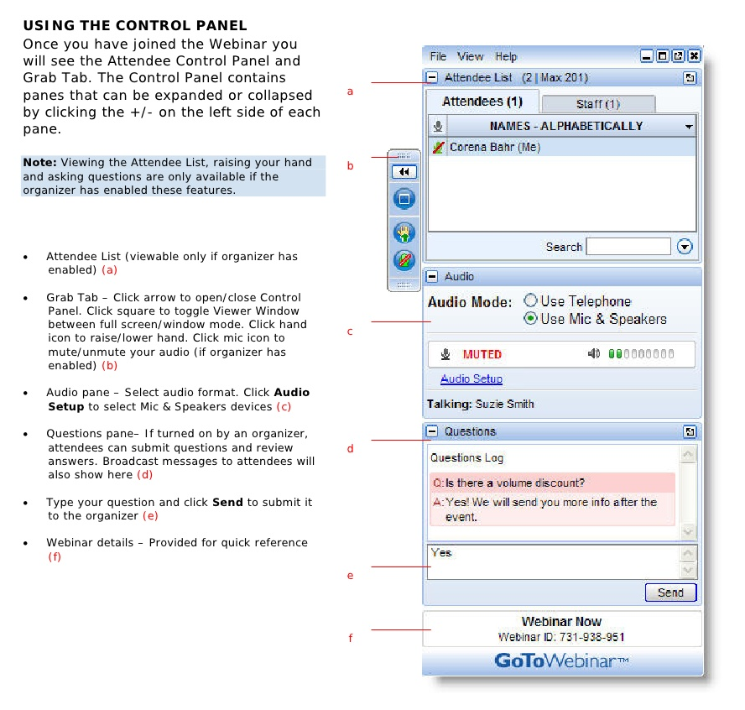
Webinar Housekeeping

Slide 4


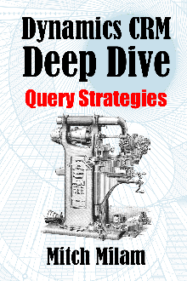
2017 Training Roadmap
Webinars
http://www.xrmcoaches.com/webinars
KnowledgeBits
http://www.xrmcoaches.com/knowledgebits
Learning Plans
http://www.xrmcoaches.com/freestuff
More Goodies
Practice tests
On–Demand video training
Instructor–led training
Books

Slide 5
Agenda
What, when, and why
Designing
Entities and Fields
Forms and Views
Views
Reports and Dashboards
Automation and Mobile
Dynamics 365-specific features

Slide 6
Configuration
vs.
Customization

Slide 7
What? (Stage 1)
Metadata
Entities
Fields
Visual Components
Forms
Views
Charts
Dashboards
Reports
Relationships

Slide 8
What? (Stage 2)
Automation (processes)
JavaScript
Business Rules

Slide 9
Typical Customization Path
Edit forms and views
Create charts and dashboards
Create new fields and entities
Create processes
Create business rules
Add JavaScript

Slide 10
Know and Understand Dynamics 365

Slide 11
Rule #1
You can’t develop against a product that you do not know

Slide 12
Know and Understand
The user interface and navigation
The terminology
Customization points
Where to get help should you need it

Slide 13
When?
When it solves a business problem
When it makes the lives of the user easier

Slide 14
Learn the Business

Slide 15
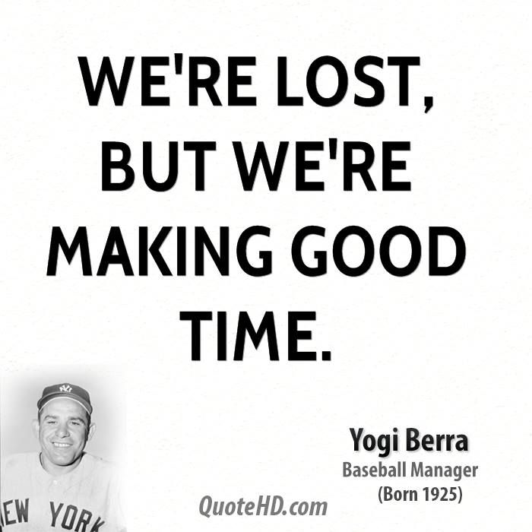
Learning the Business
Before you can automate the business, you have to know what parts can be automated

Slide 16
Rule #2
Technology does not solve process issues

Slide 17
Rule #3
It is NOT about you.
It IS about the user.

Slide 18
Why?
What is the purpose of the customization?
Audience
Everyone
Special Groups

Slide 19
Getting Started

Slide 20
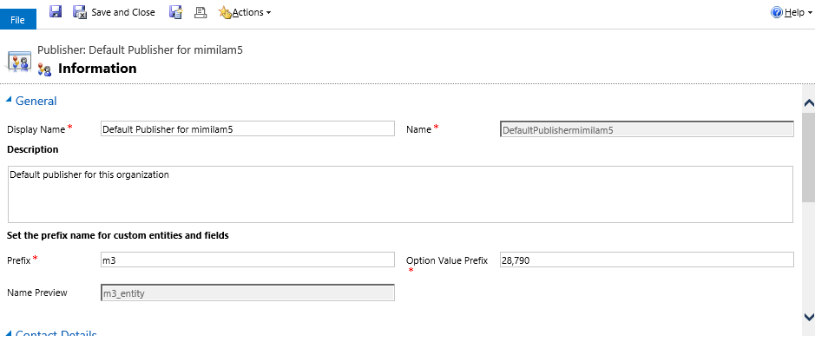
Edit the Default Publisher

Slide 21
Entities

Slide 22
Entities Best Practices
Whenever possible, use the out of the box entities for their intended purpose
Do not recreate existing entities, unless absolutely required by a business case

Slide 23
Fields

Slide 24
Fields Best Practices
Do not repurpose a field, just create a new one
Consider always using Global Option Sets

Slide 25
Forms

Slide 26
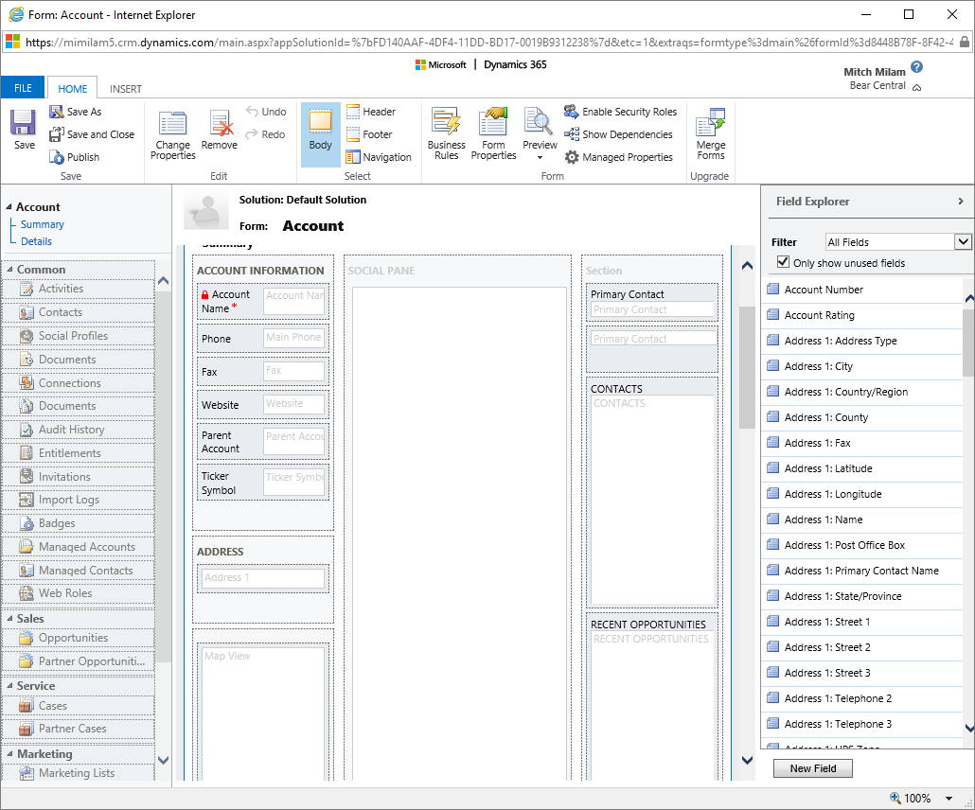
Form Designer

Slide 27
Tip: Keyboard Shortcuts
Arrow Keys
Move the selected item
Delete key
Deletes an item
Enter Key
Displays the property dialog
Ctrl+Z, Ctrl+Y, Ctrl+S
Undo, Redo, Save

Slide 28
Form Designer

Slide 29
Form Designer-Tabs
Tabs can have columns
Column width can be adjusted
Tabs can be visible by default
Tabs can be collapsed by default

Slide 30
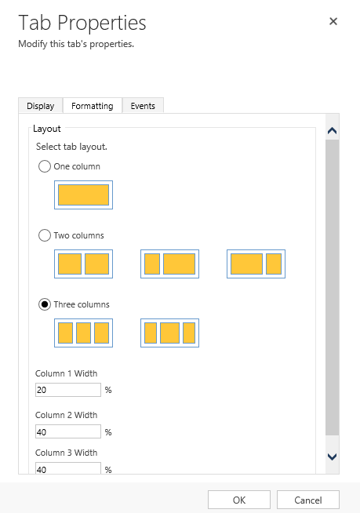
Form Designer-Tabs

Slide 31
Form Designer-Sections
Section layout can be changed
Any time after creation
Sections can be visible by default

Slide 32
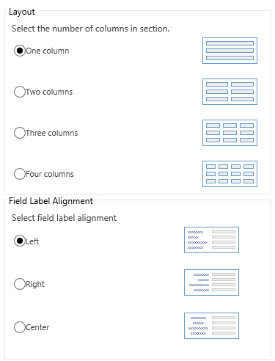
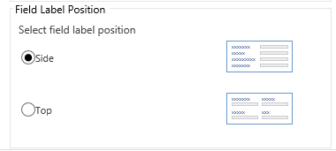
Form Designer-Sections

Slide 33
Form Designer-Fields
Field label alignment (controlled by Section)
Left, right, or center
Field label position (controlled by Section)
Side, top
Fields can be visible by default

Slide 34
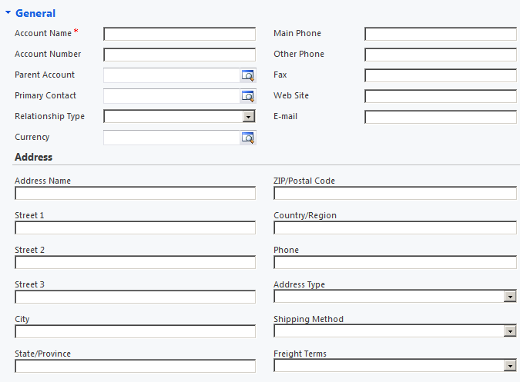
Example: Field Label Placement

Slide 35
Form Design Advice
Don’t go crazy
Keep fields to the minimum required
Collapse tabs with seldom-used fields
Keep subgrids to a minimum or place into a collapsed tab
Don’t go crazy

Slide 36
Form Design Tip
Use Configuration over Code when setting the default state of a Tab, Section, or Field

Slide 37
Forms: Make a Backup
Open the form you wish to customize
Perform a Save As operation
Set the Form Order to move the new form to the top of the list

Slide 38
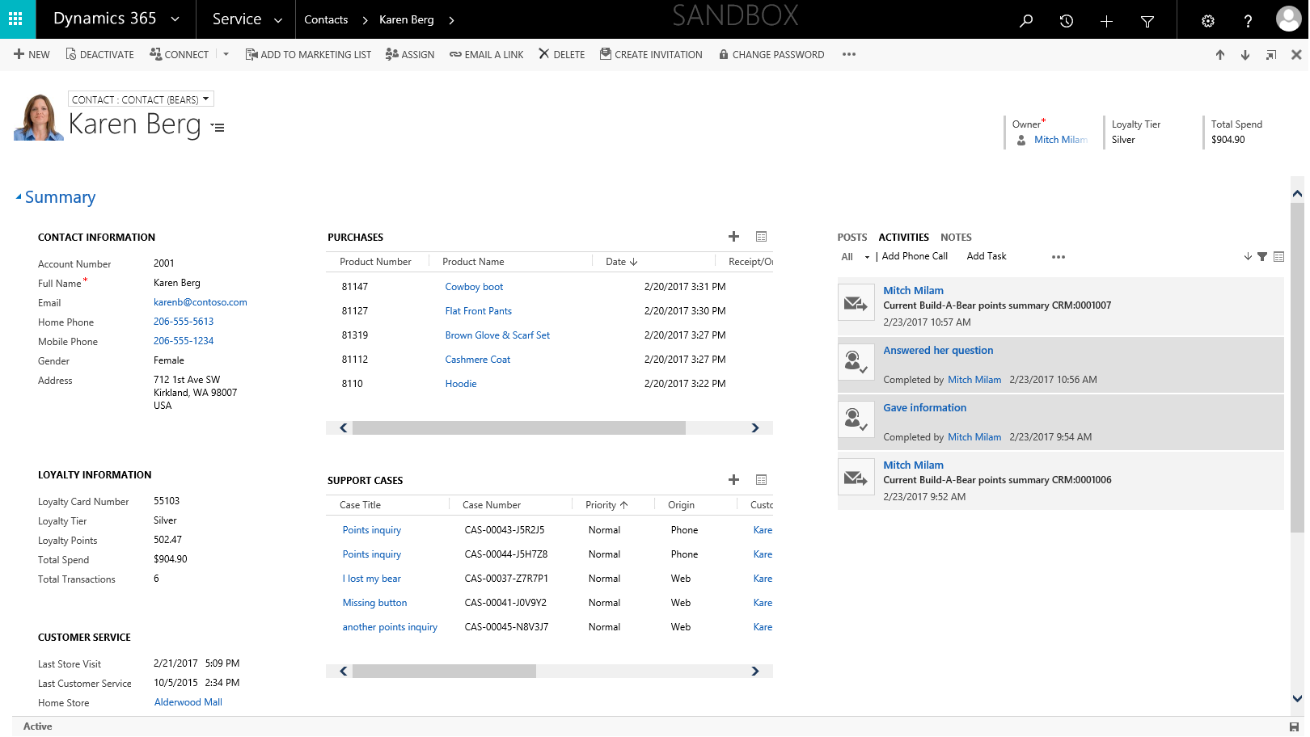
Don’t Be Afraid to Experiment

Slide 39
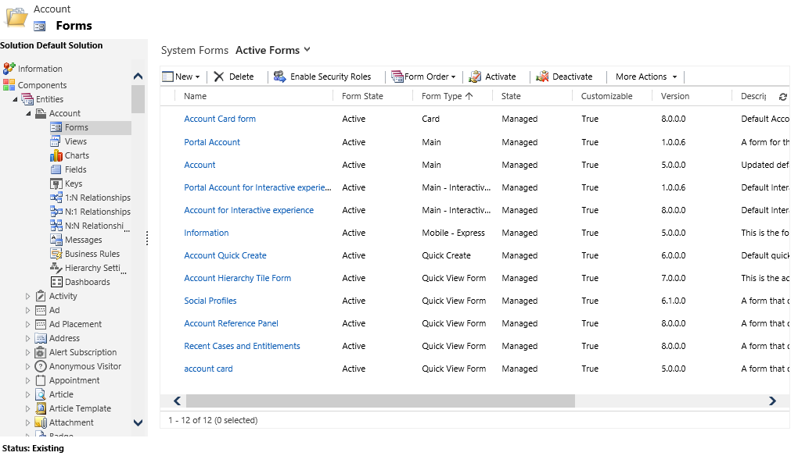
More Than Just the Main Form

Slide 40
Views

Slide 41
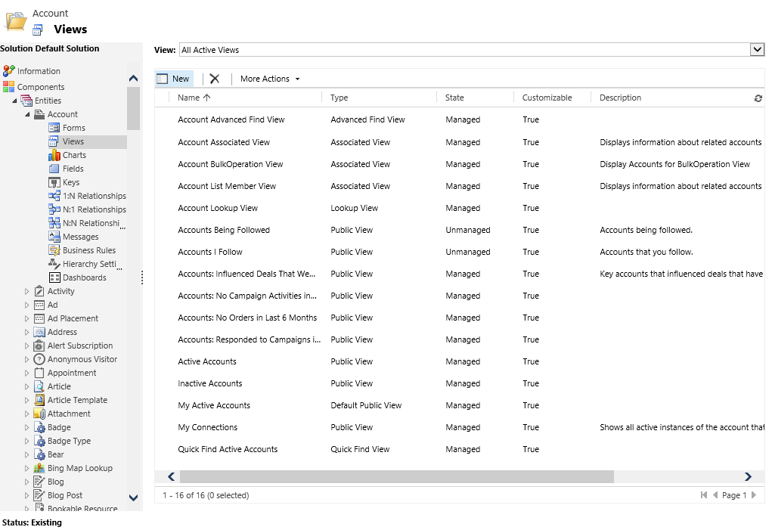
Standard Views (Account)

Slide 42
View Considerations
What is the Default Public View?
Is the design and layout of the views meeting the needs of the user community?
Would custom views with different filter criteria make the user more efficient?
Does the user need an Editable Grid?

Slide 43
Reports and Dashboards

Slide 44
Reports and Dashboards
What exactly is a report, anyway?
View
Chart
Power BI tile
SSRS report
Excel worksheet
Word document

Slide 45
Implementing Dashboards
Charts
Lists (Views)
iFrames
Power BI

Slide 46
Automation

Slide 47
Processes
Workflows
Dialogs
Business Process Flows
Business Rules

Slide 48
Workflows
What COULD you automate?
What SHOULD you automate

Slide 49
Workflows
Standard, repeatable, processes provide the most value when automated

Slide 50
JavaScript
Business Rules vs. JavaScript
When do you switch?
What do you need to know?
I am a developer now?

Slide 51
Mobile

Slide 52
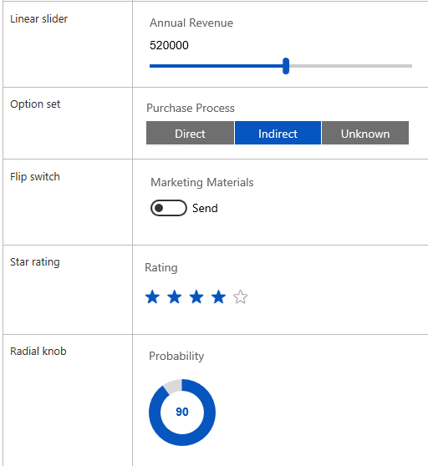
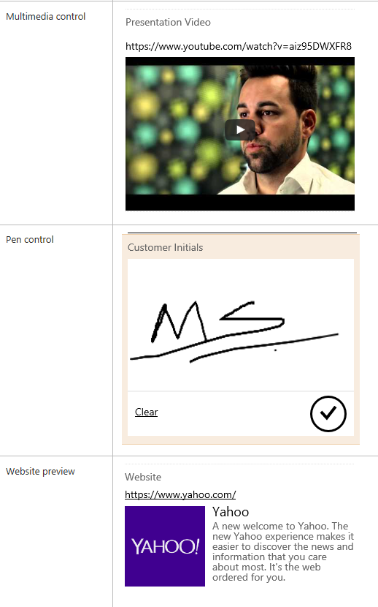
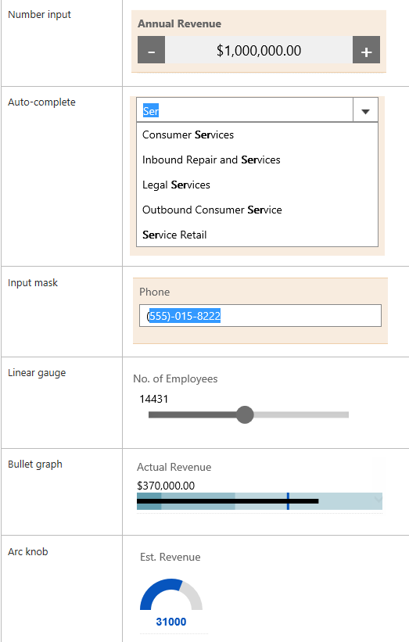
Mobile-Only Controls

Slide 53
Dynamics 365-Specific Features

Slide 54
Dynamics 365 Business Apps
Role-based business apps
Simple and intuitive
Make it easier for users to quickly find the things they need to do every day

Slide 55
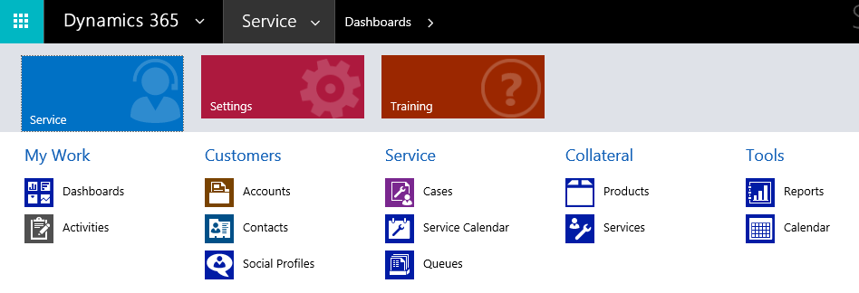
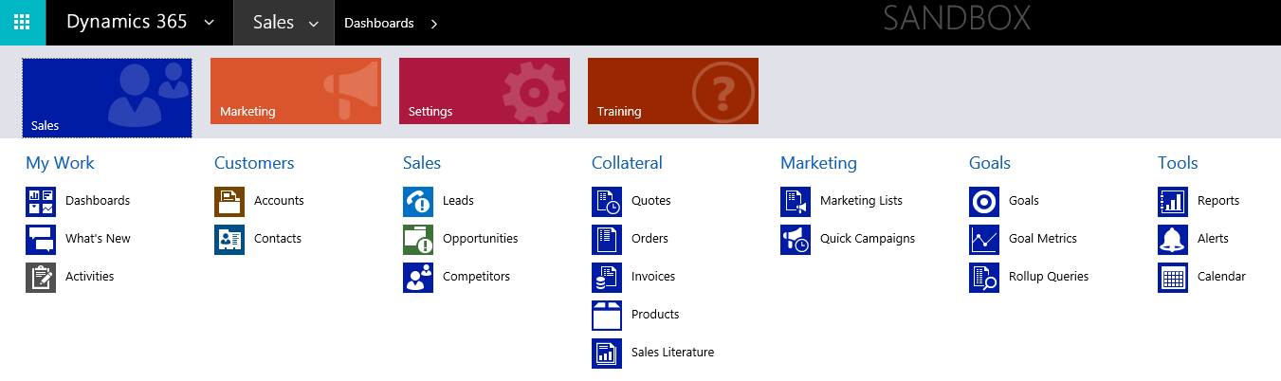
Dynamics 365 Business Apps

Slide 56
More Features
Editable Grids
Embedded Power BI
Power Apps
Microsoft Flow
Project Service Automation (PSA)
Field Service
Office 365 Groups

Slide 57
Questions?

Slide 58
Thank You

